Slide 1


Slide 2
Arithmetic Operators
ADDITION
SUBTRACTION
DIVISION
MULTIPLICATION

Slide 3
Create table emp (ename varchar(10),salary(10));
Insert into emp values(‘bhavneet’,2000);
Select ename, salary+1000 from emp;
Select ename, salary-1000 from emp;
Select ename, salary*1000 from emp;
Select ename, salary+1000 from emp;
Select ename, salary/1000 from emp;

Slide 4
Alias with Select Command
SQL aliases are used to give a table, or a column in a table, a temporary name.
Alias is used to rename the column name while displaying data. But the actual column name in the structure does not change.
Alias Column Syntax
SELECT column_name AS alias_name
FROM table_name;

Slide 5
Example-
SELECT CustomerID AS ID, CustomerName AS Customer
FROM Customers;

Slide 6
Concatenation Operator
Represented by vertical Bars
Concatenates columns or character strings to others and creates the resultant column .
SYNTAX: select column-name1|| column-name2 from table-name;
Select ename||salary from emp;
Select ename||’has salary’||salary as output from emp

Slide 7
Select command with Between Operator
Between operator is used to select the data that is within a specified range of values.
It returns only those values which have values within lower and upper limit.
SYNTAX: select * from tablename where column-name between lower limit and upper limit;
Select * from emp where salary between 10000 and 12000;
SELECT MIN(column_name) FROM table_name;
SELECT Max(column_name) FROM table_name;

Slide 8
Select Command With Like Operator
The LIKE operator is used in a WHERE clause to search for a specified pattern in a column.
There are two wildcards often used in conjunction with the LIKE operator:
  % - The percent sign represents zero, one, or multiple characters
  _ - The underscore represents a single character
LIKE Syntax
  SELECT column1, column2, ...
  FROM table_name
  WHERE columnN LIKE pattern;

Slide 9
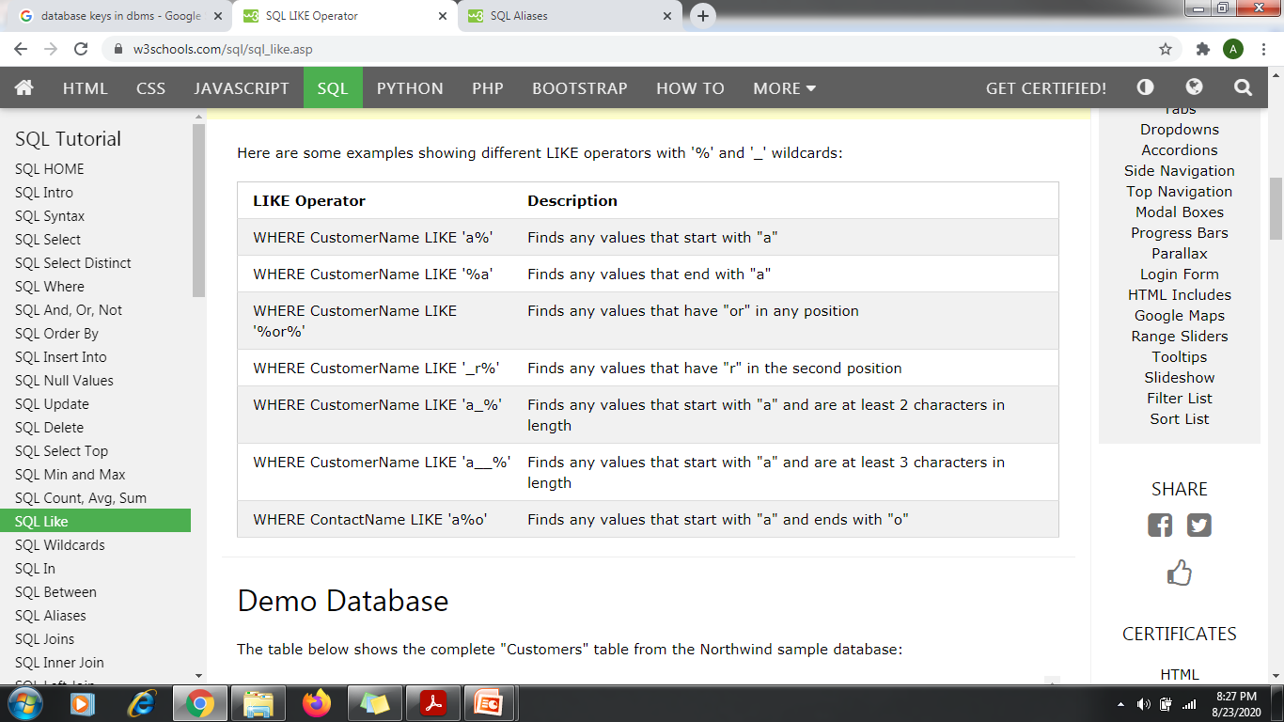

Slide 10
Example
SELECT * FROM Customers
WHERE CustomerName LIKE 'a%';
SELECT * FROM Customers
WHERE CustomerName LIKE '%a';
SELECT * FROM Customers
WHERE CustomerName LIKE '%or%';
SELECT * FROM Customers
WHERE CustomerName LIKE '_r%';
SELECT * FROM Customers
WHERE CustomerName LIKE 'a__%';
SELECT * FROM Customers
WHERE CustomerName NOT LIKE 'a%';

